Slide 1
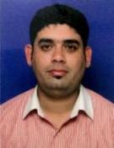
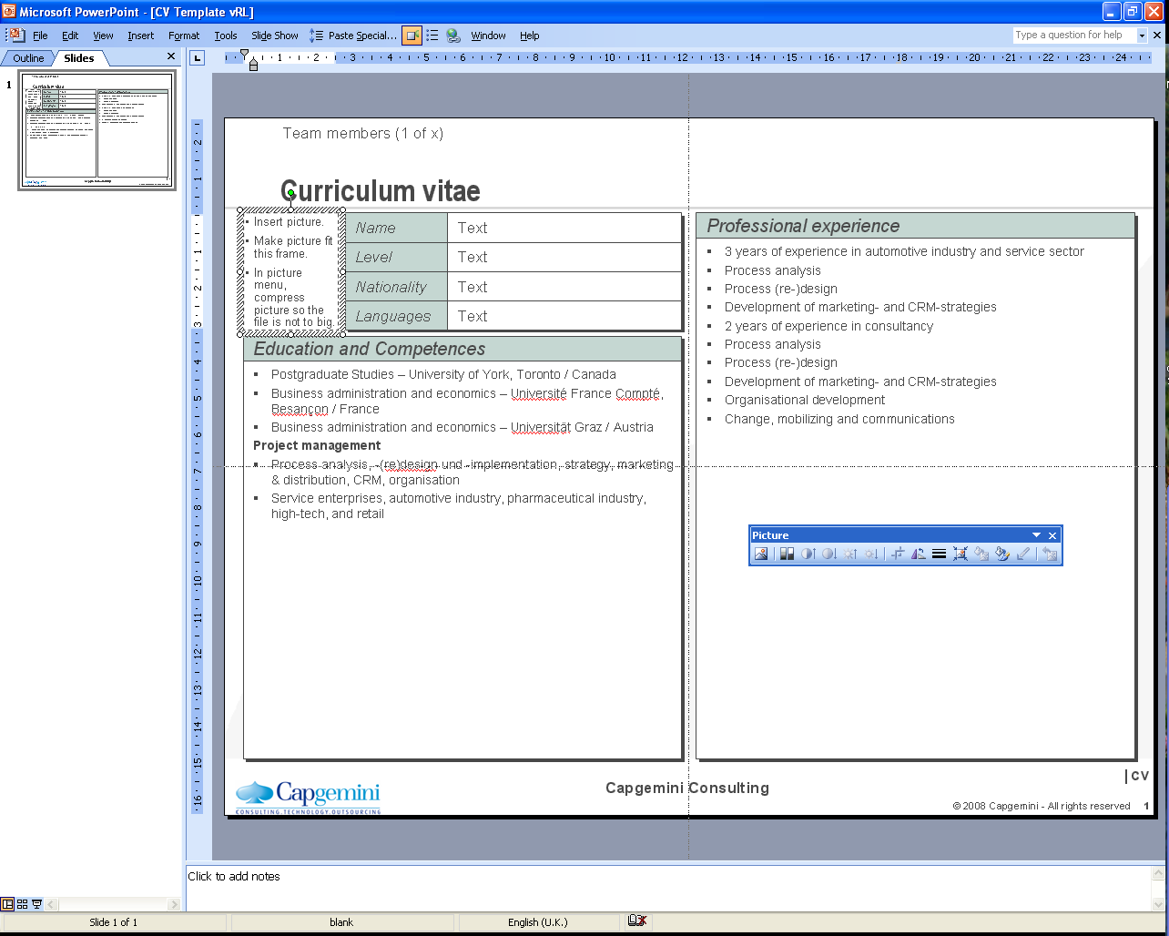
Name: Vijay Raut Role: Software Consultant
Photo to be placed
Name
Vijay Raut
Professional experience
Practice
DCX
Capgemini Pune-
Software Associate Consultant March 2015 – Oct 2016
• GSP Front End (FE) is FSA 2.0 architecture developed using dojo framework. GSP has common Channel Service (CS) layer for all entities. Dojo modules access CS using REST web service calls through AJAX. Business Service (BS) layer is developed using Spring Integration (SI) framework and SOAP web services. BS have separate modules in SI for each country and configured as per country's backend capabilities. Based on region code BS module for that country is invoked using routers from Integration framework. Backend is legacy mainframe system (different systems and configurations for different countries) which is accessed throw IBM MQueue. This communication is done using proprietary messaging standard developed by client.
Software Consultant Oct 2016 – Till Date
Software Consultant for HSBC’s GSP(Global Service Platform) which provides internet banking functions needed HSBC’s customer. Led a team of 4 people comprising UI Devloper/Designer and Java developers.
Ezest Solutions Pune-
Software Developer Aug 2013- Mar 2015
Joined Ezest solution Private Limit as software engineer .
Converting current internet based online application for iPhone, iPad, Androide Phone & Tabs. There were around four eight, country specific applications for iPhone, iPad, Androide Phone & Tabs. This mobile APPs are designed for the use of bank account holders to perform their day to day account transactional & informational activities using their smart phones and tabs.
Free lancing (Self employed) Pune-
Software Developer Jan 2012- Aug 2013
Worked as self employed.
Design and development of online property management website portal where user can search for the property for rent with amenities, locality and owner can manage the different properties using AngularJS, HMTL, CSS.
Aptara Pune-
Senior Programmer April 2010- Dec 2011
Joined Aptara as a Senior Programmer.
Worked on Existing application had serious cross browser compatibility issues. Development teams had several layout issues issues for different browsers Like IE 6, IE 7 and Mozilla Firefox.
Nationality
Indian
Residence
Pune
Insert picture.
Make picture fit this frame.
In picture menu, compress picture so the file is not to big.
Role
Software Consultant
Profile
5.8 years of experience in Mobile/Web Development - working across domains like E- Commerce, BFS.
Microsoft certified HTML5, CSS3, Javscript, Jquery, Ajax, Json
Developed Hybrid application for android, iOS devices, tablets and Smart phones using HTML5, CSS, jquery, JavaScript.
Developed Web application using HTML5, CSS, jquery, JavaScript, Dojo, Angular.
Knowledge of Bootstrap, Foundation 5, Block element modifiers(Saas, Less) for development of hybrid application.
Working on accessibility using tools Jaws, NVDA.
Flexible when working with others and devoted to seeing each project through to the end.
Working experience to support projects at different environments i.e. SIT (System Integration testing), UAT (User acceptance Testing), Production and go-Live support.
Competencies
Android and Web development
Angular JS, JavaScript, jQuery, DOJO, XML, HTML5, CSS3, JSON, AJAX, Java, JSP.
Tools: GIT, SVN, Jenkins, Eclipse, IBM RTC, JIRA.
App Servers: Tomcat5, WebSphere and Apache
Application Development, Maintenance & Production Support of Web Applications
Education & Training
Bachelor of Science in Computer Science from Pune University
Angular, DOJO, React
© 2010 Capgemini - All rights reserved

